Slide 1


Slide 3
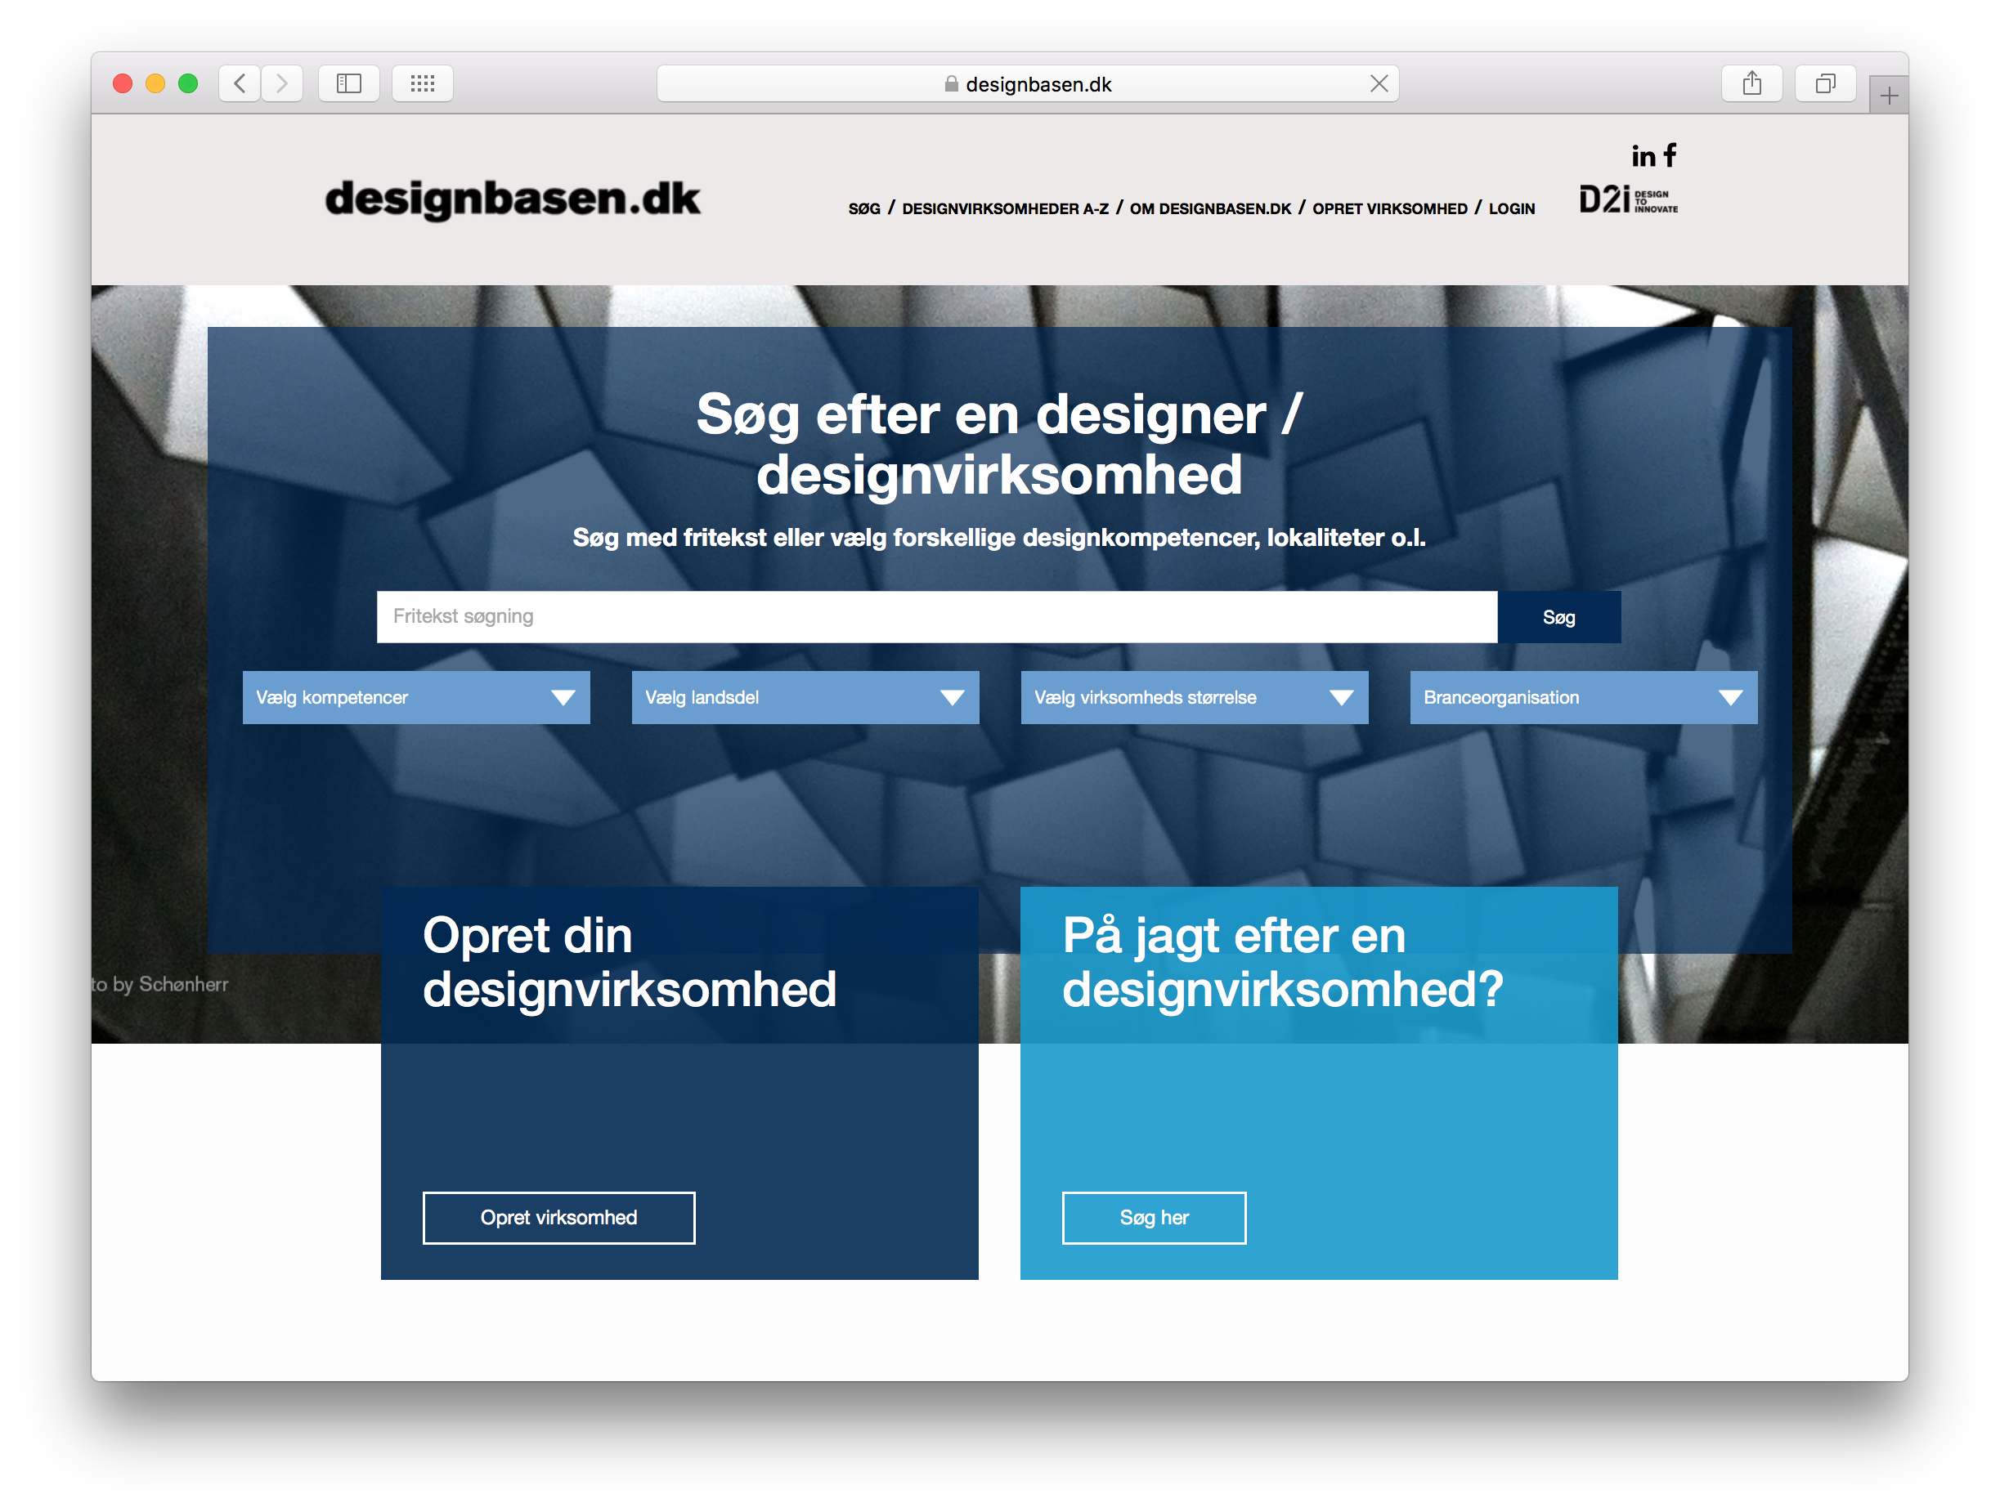

Slide 4
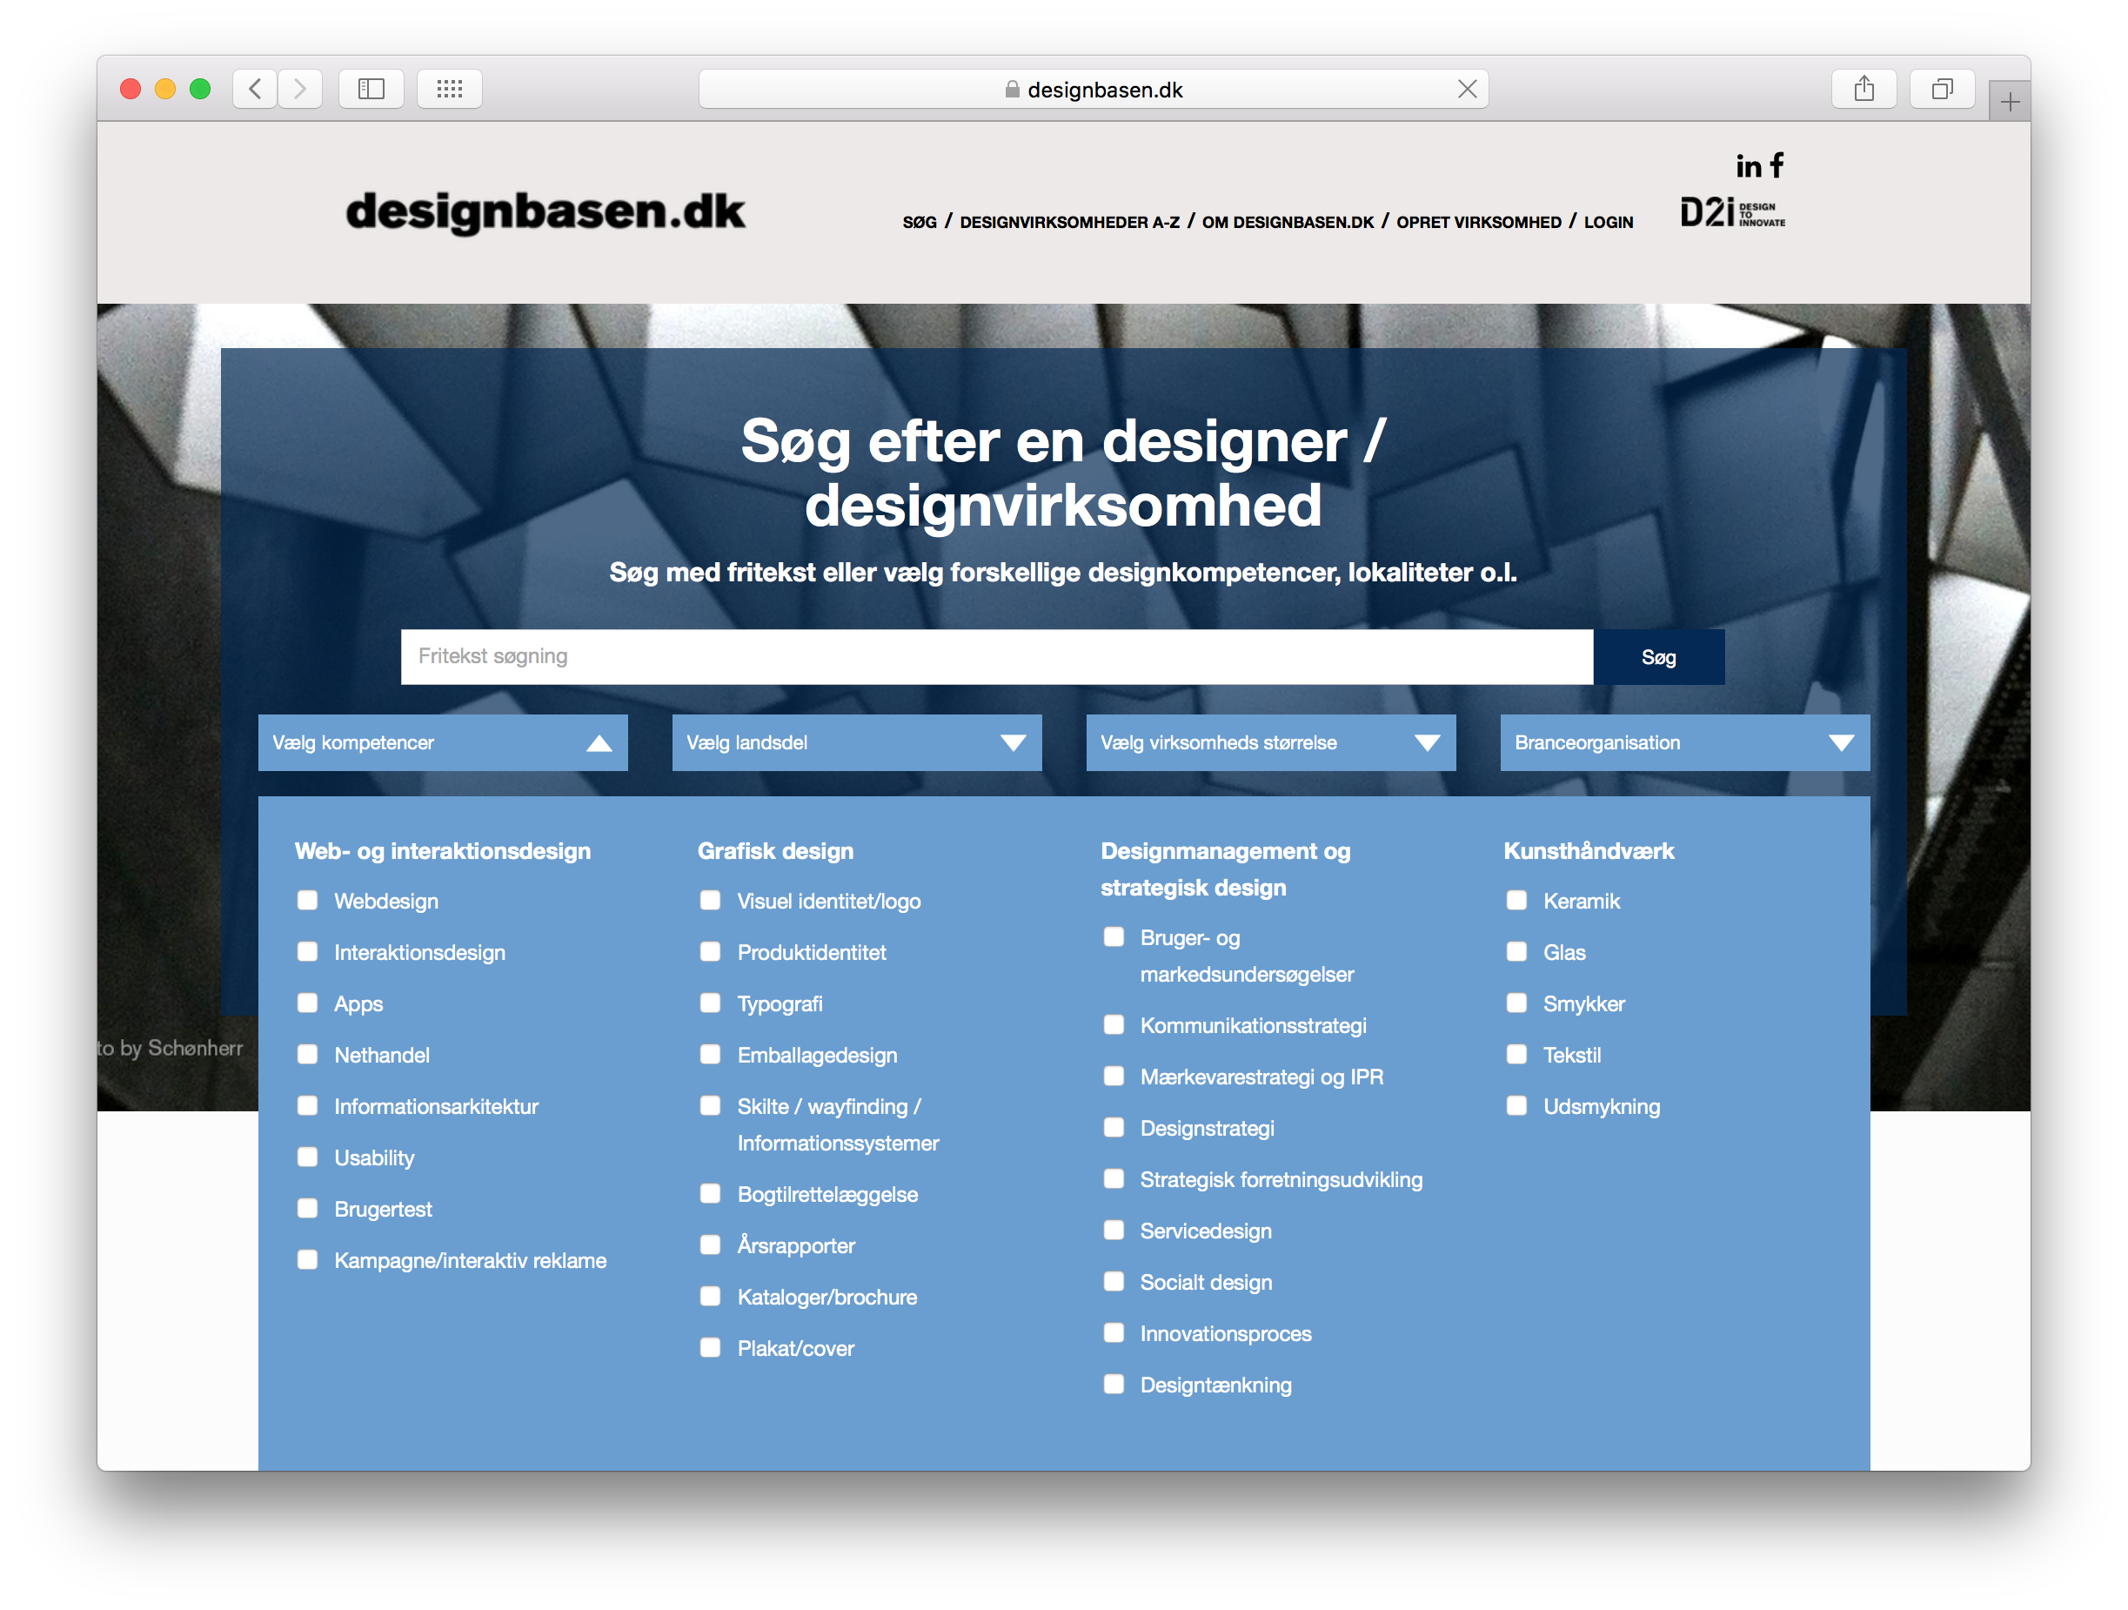

Slide 5
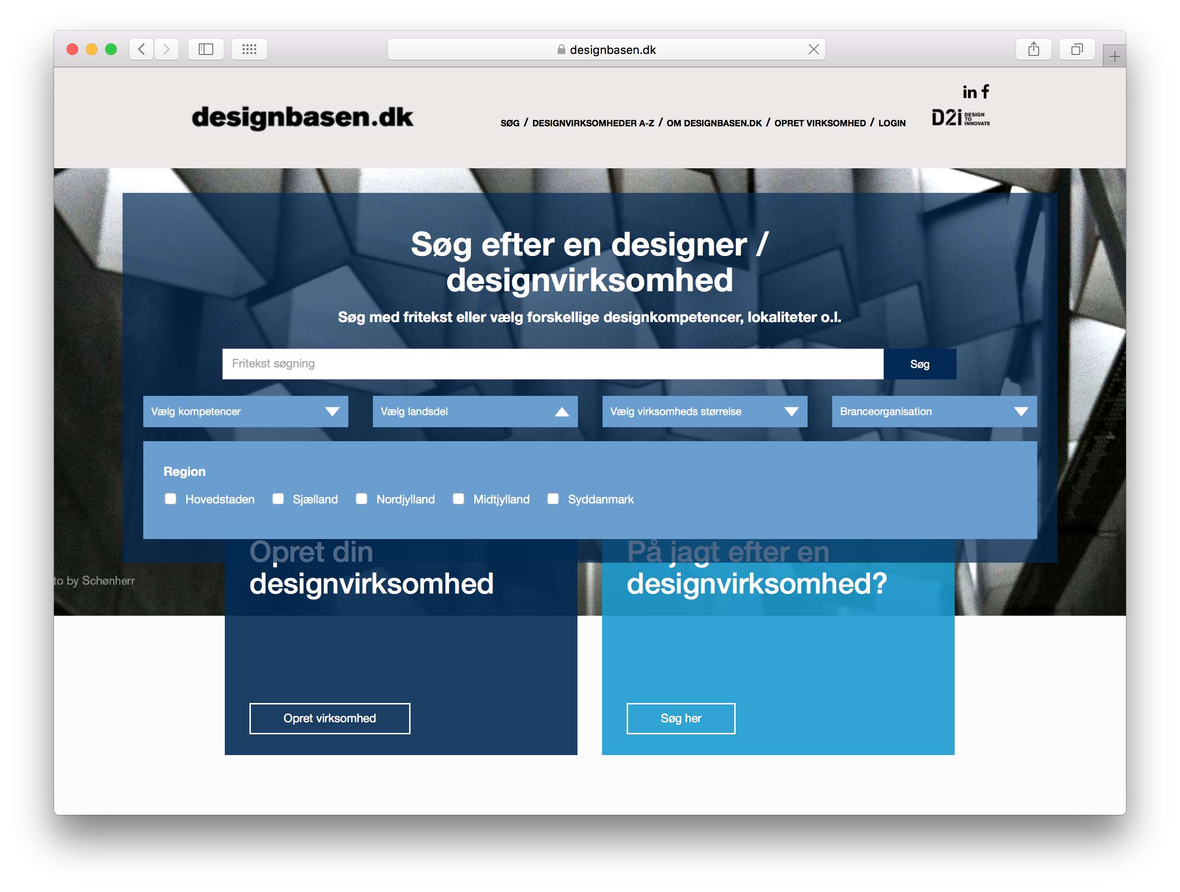

Slide 6
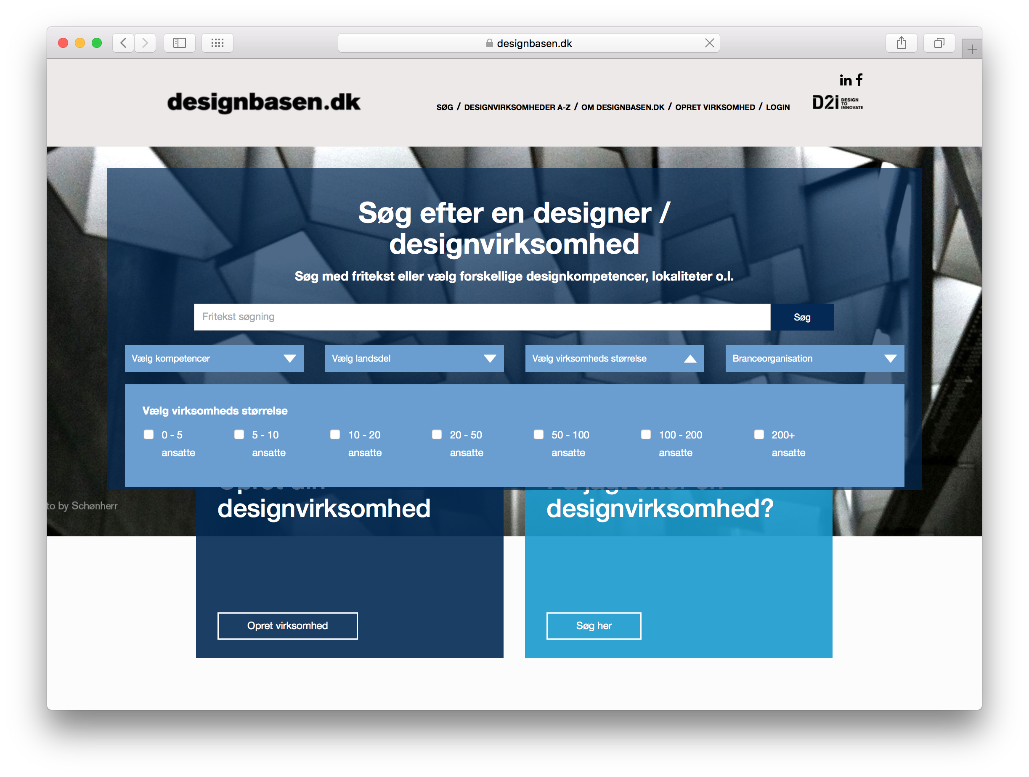

Slide 7
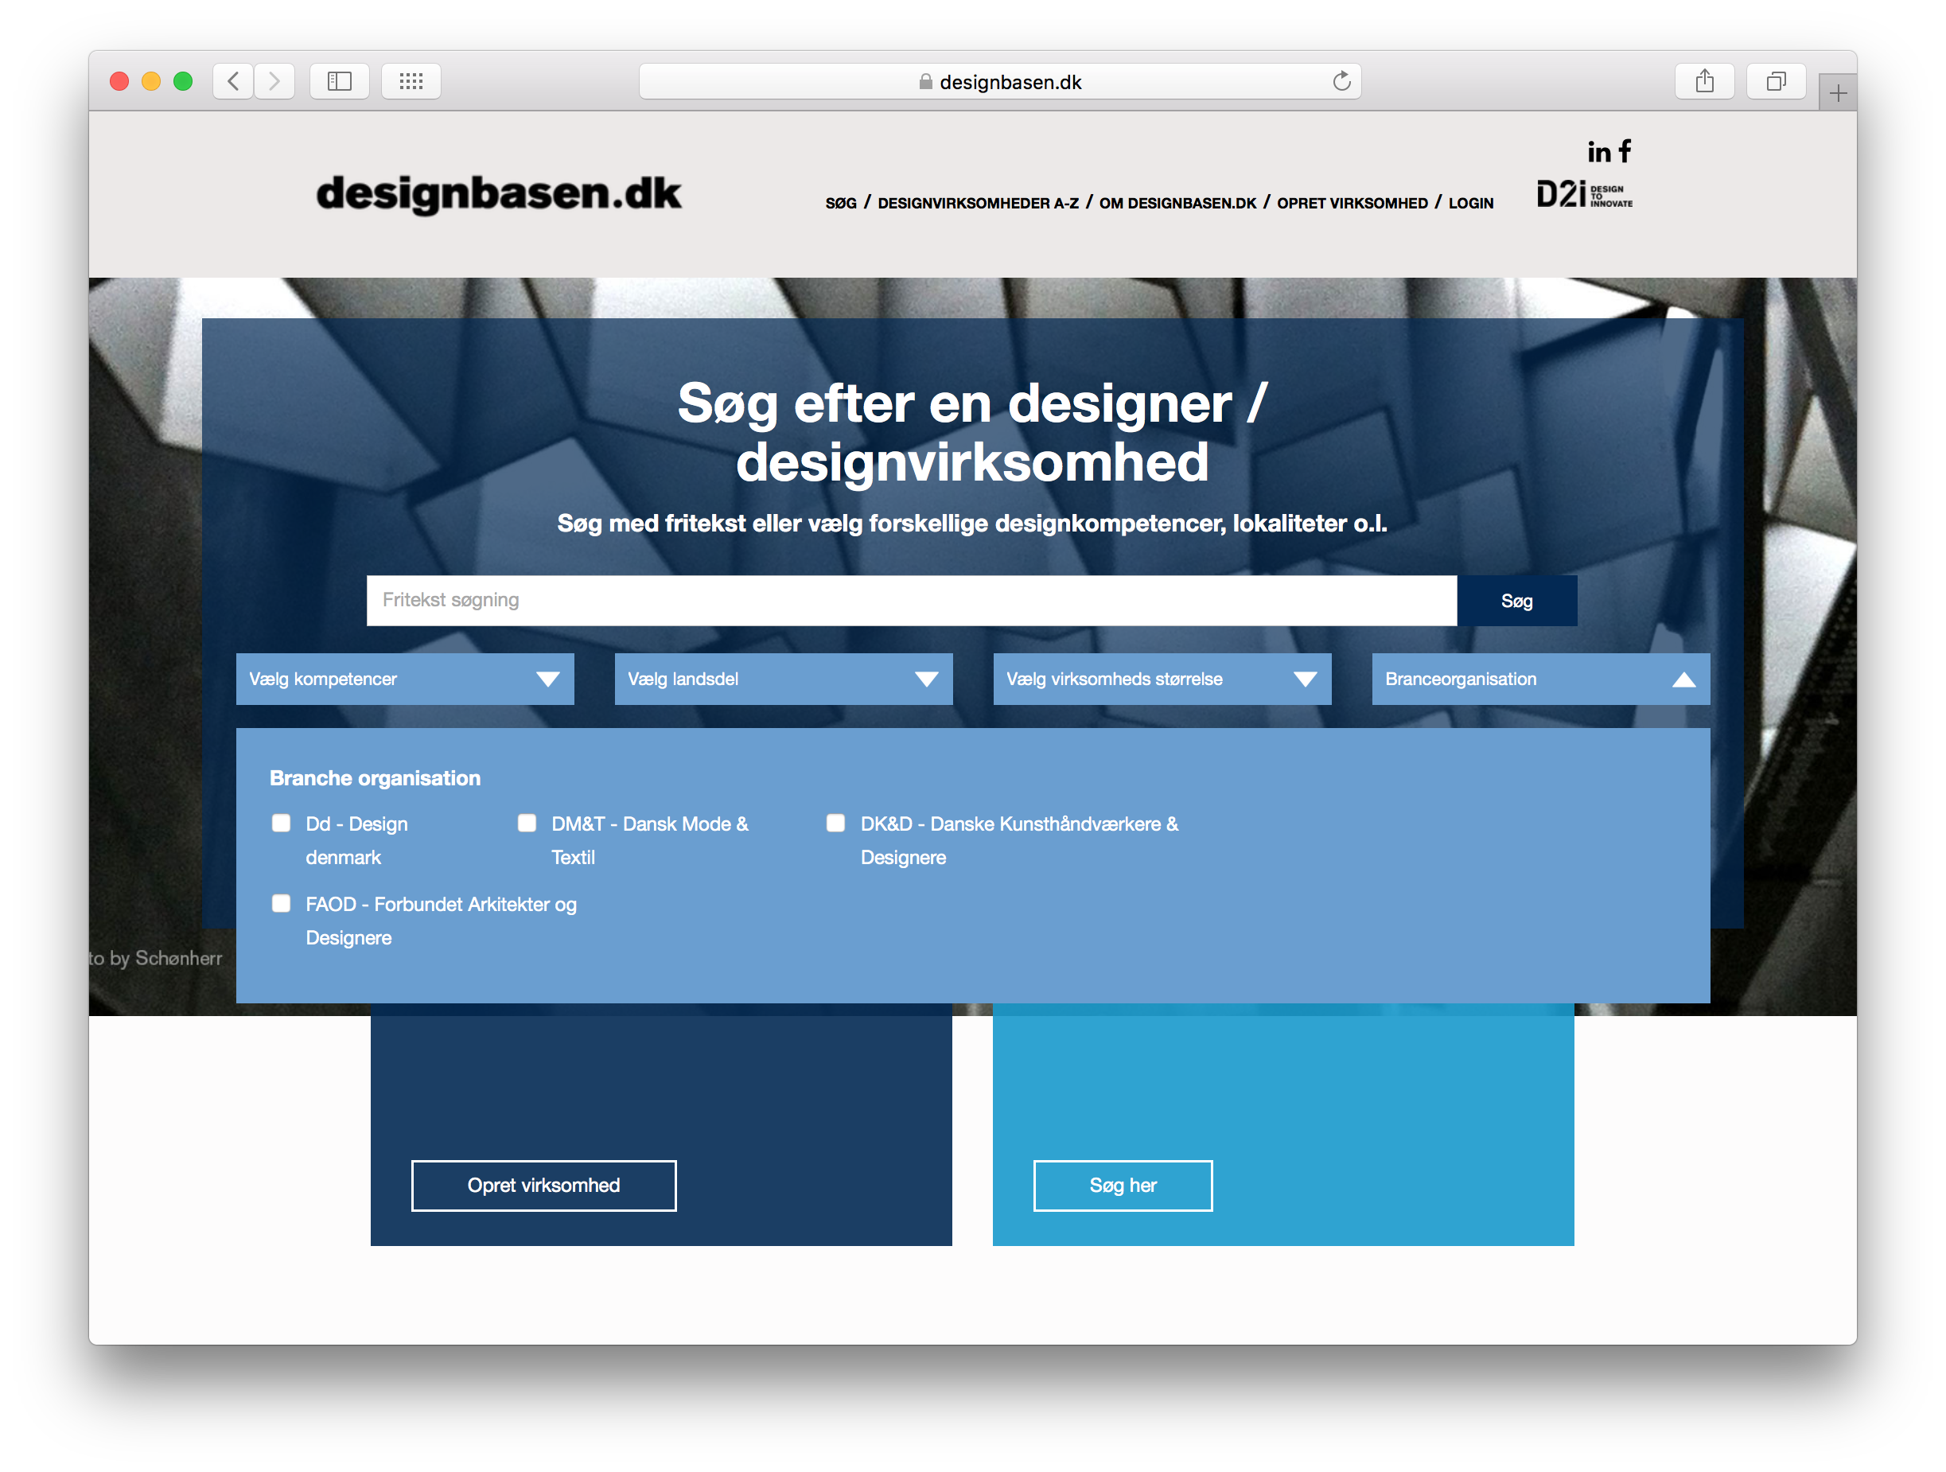

Slide 8
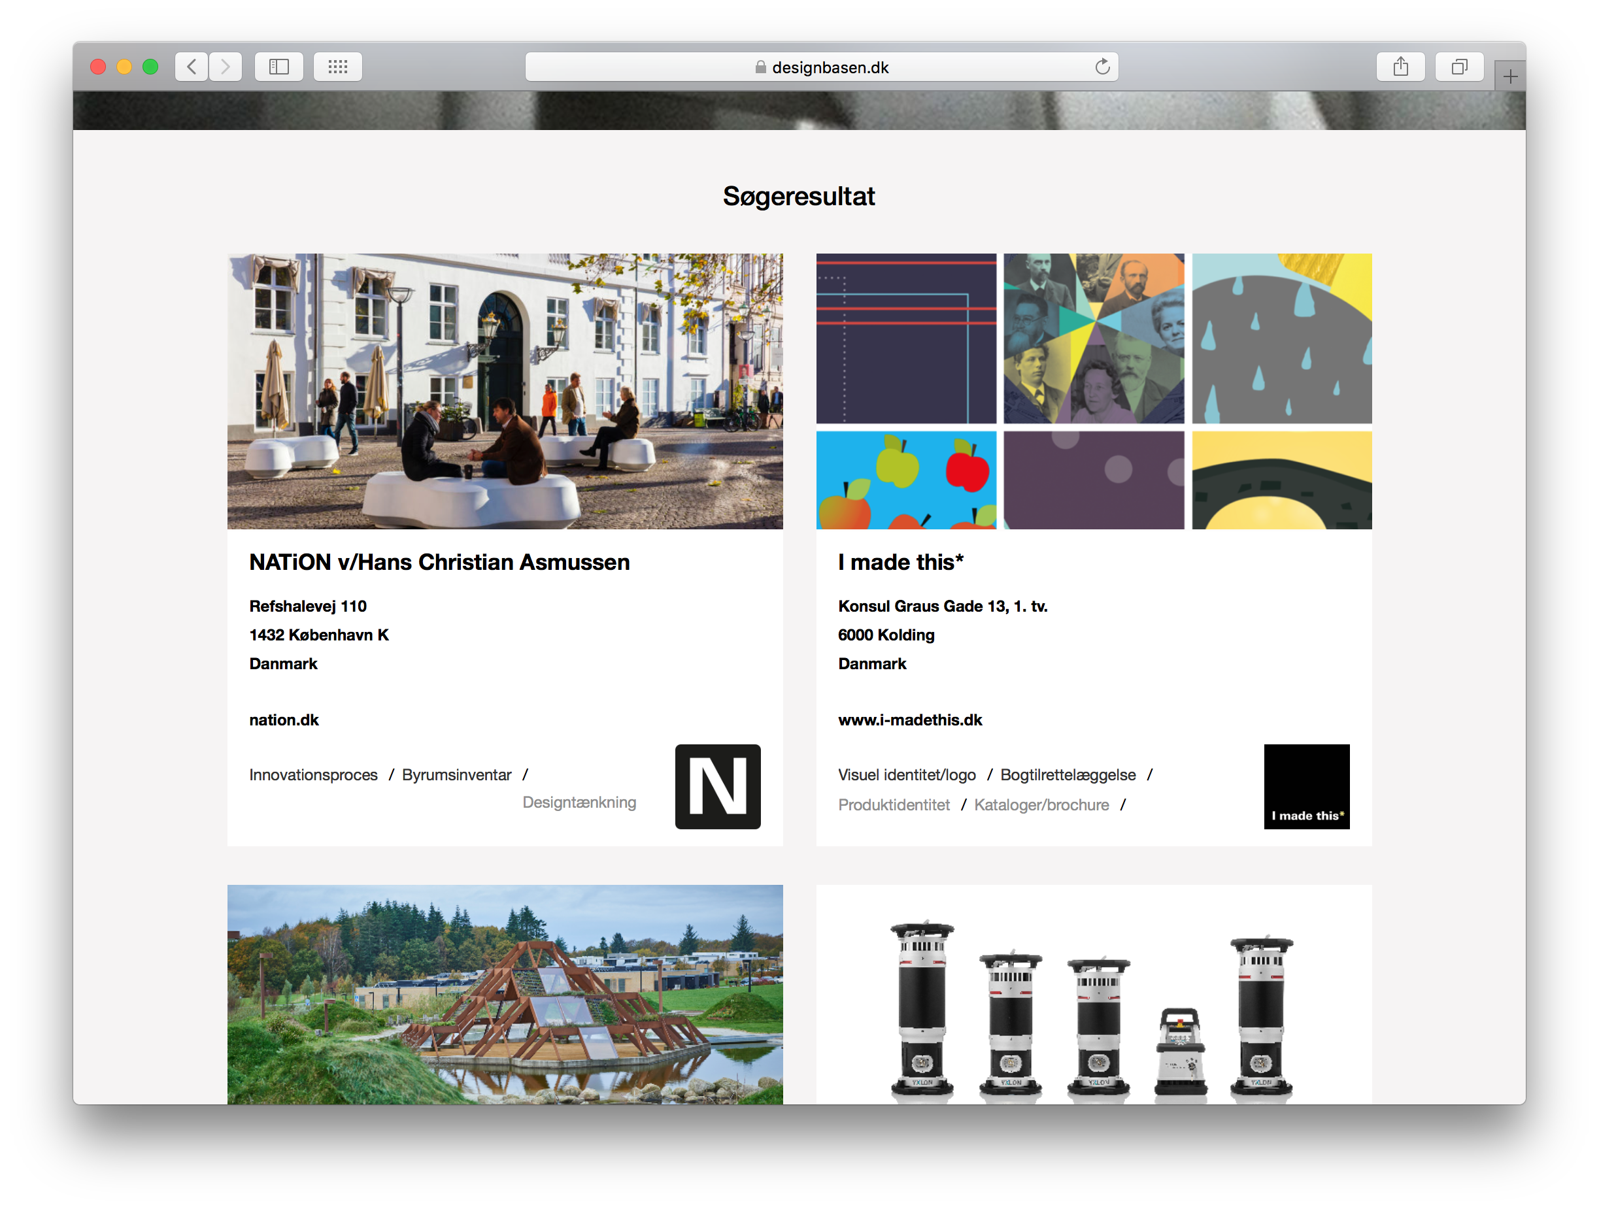

Slide 9
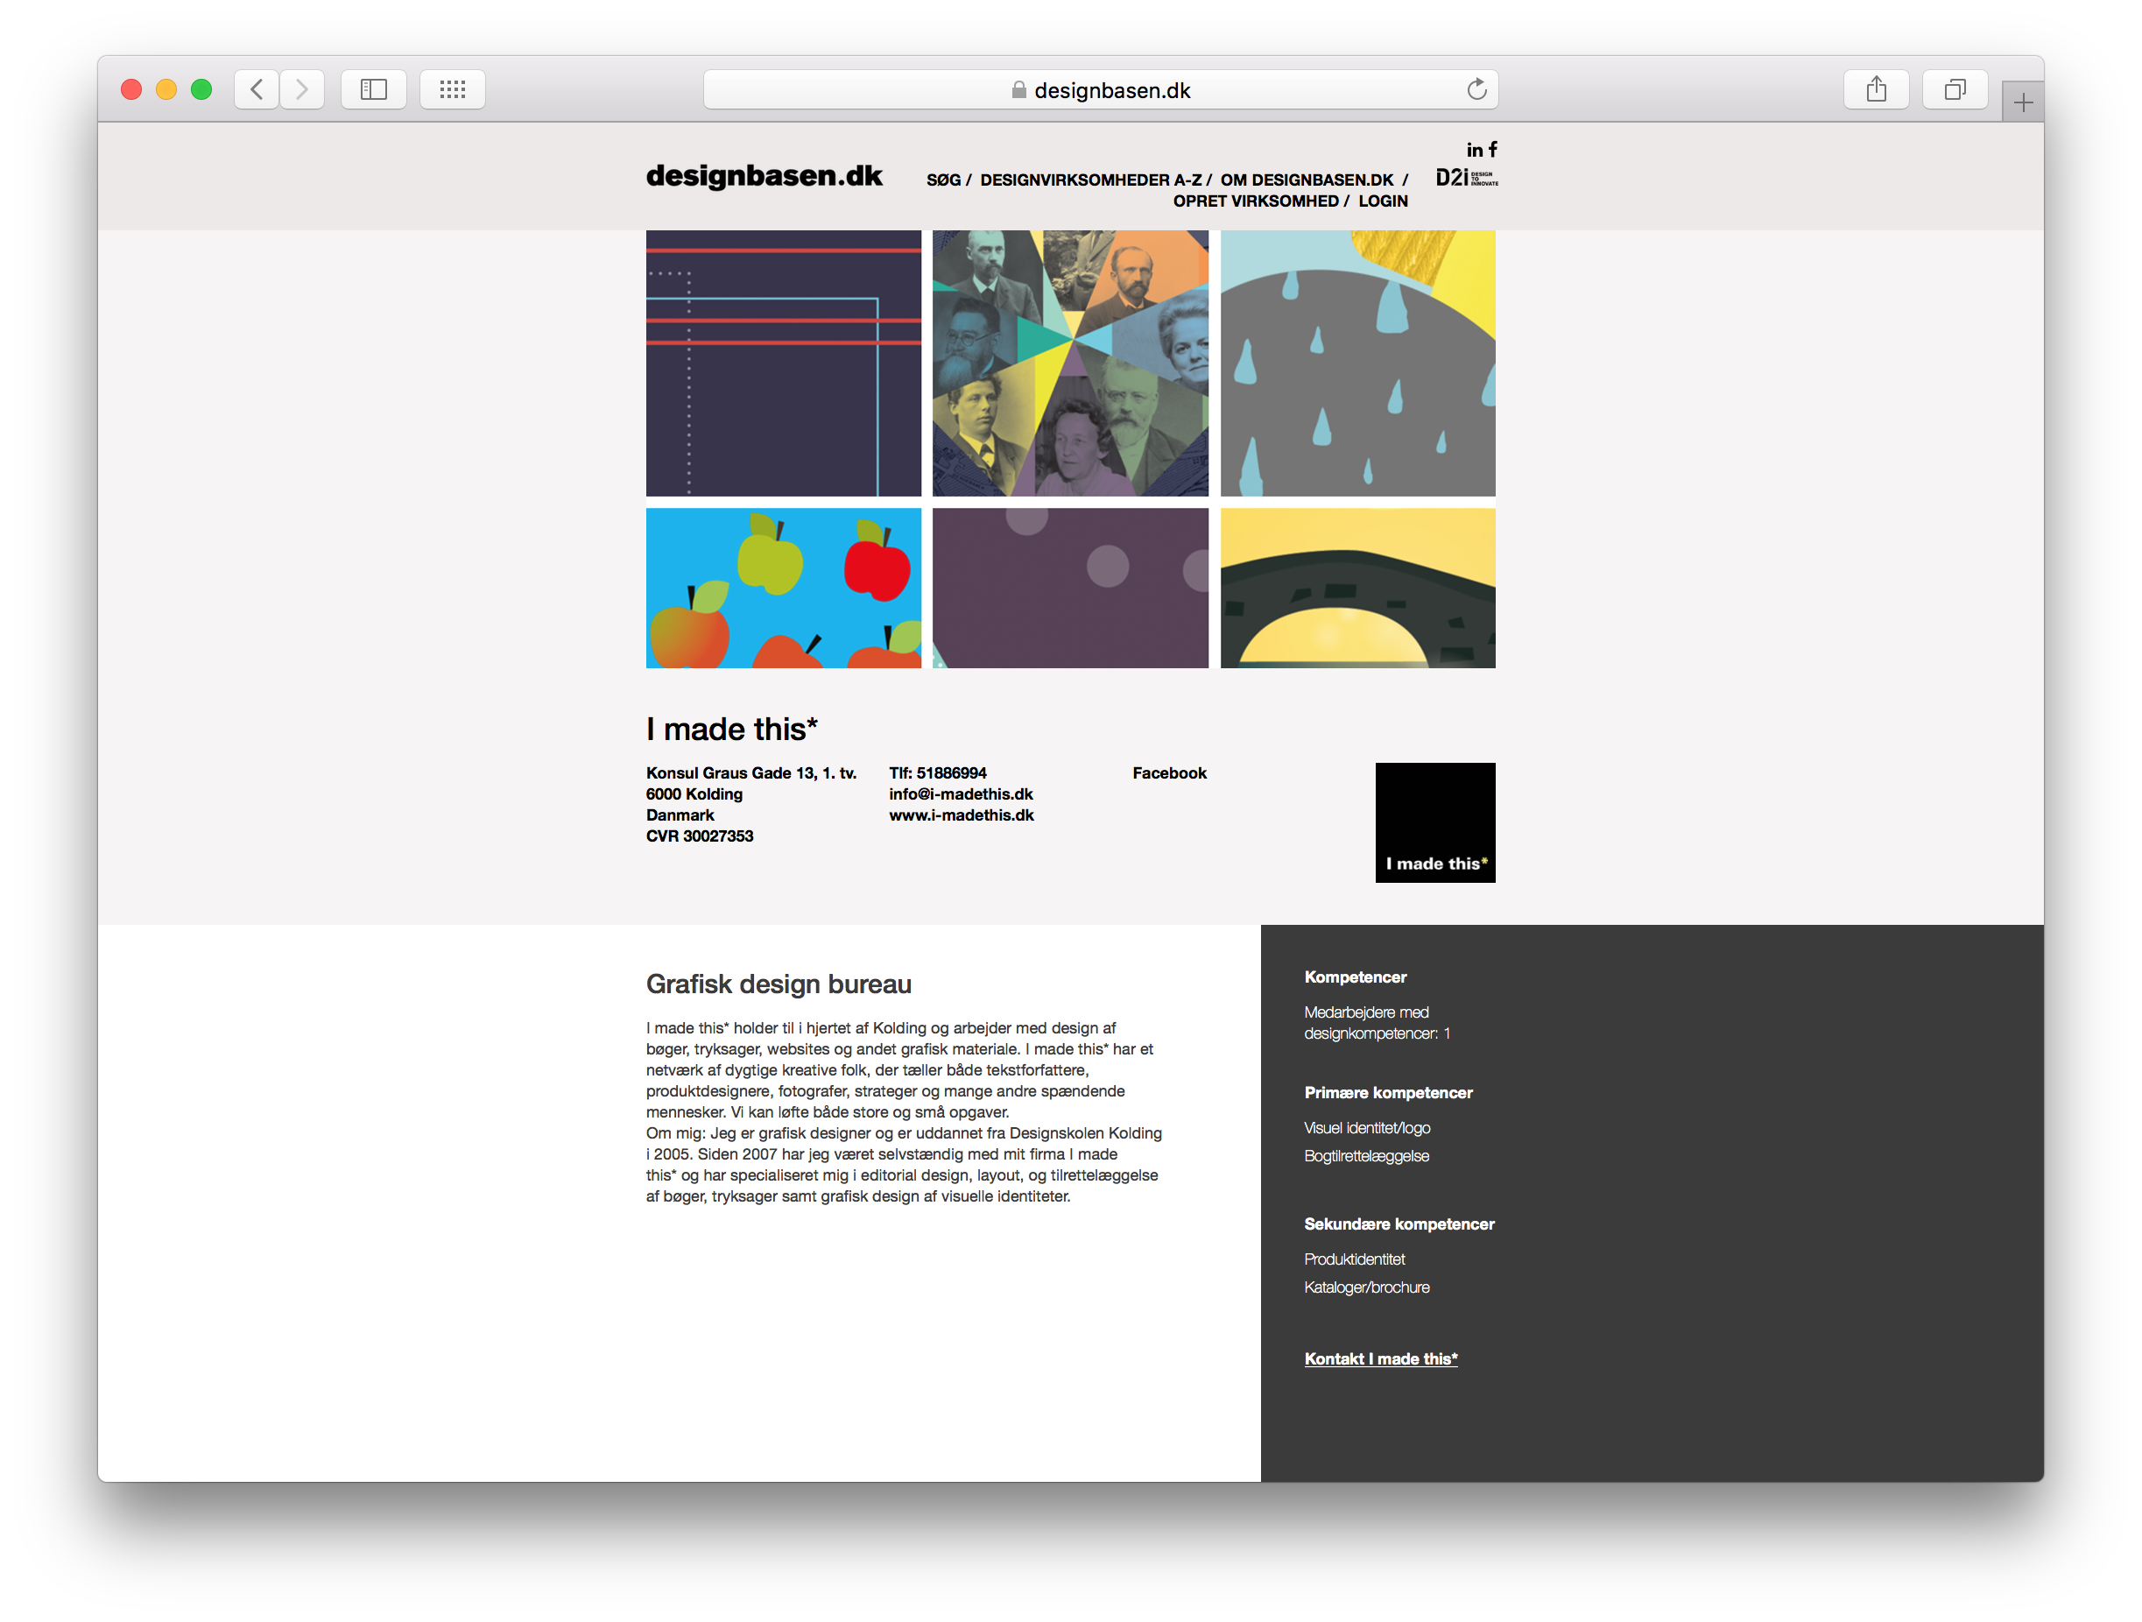

Slide 10
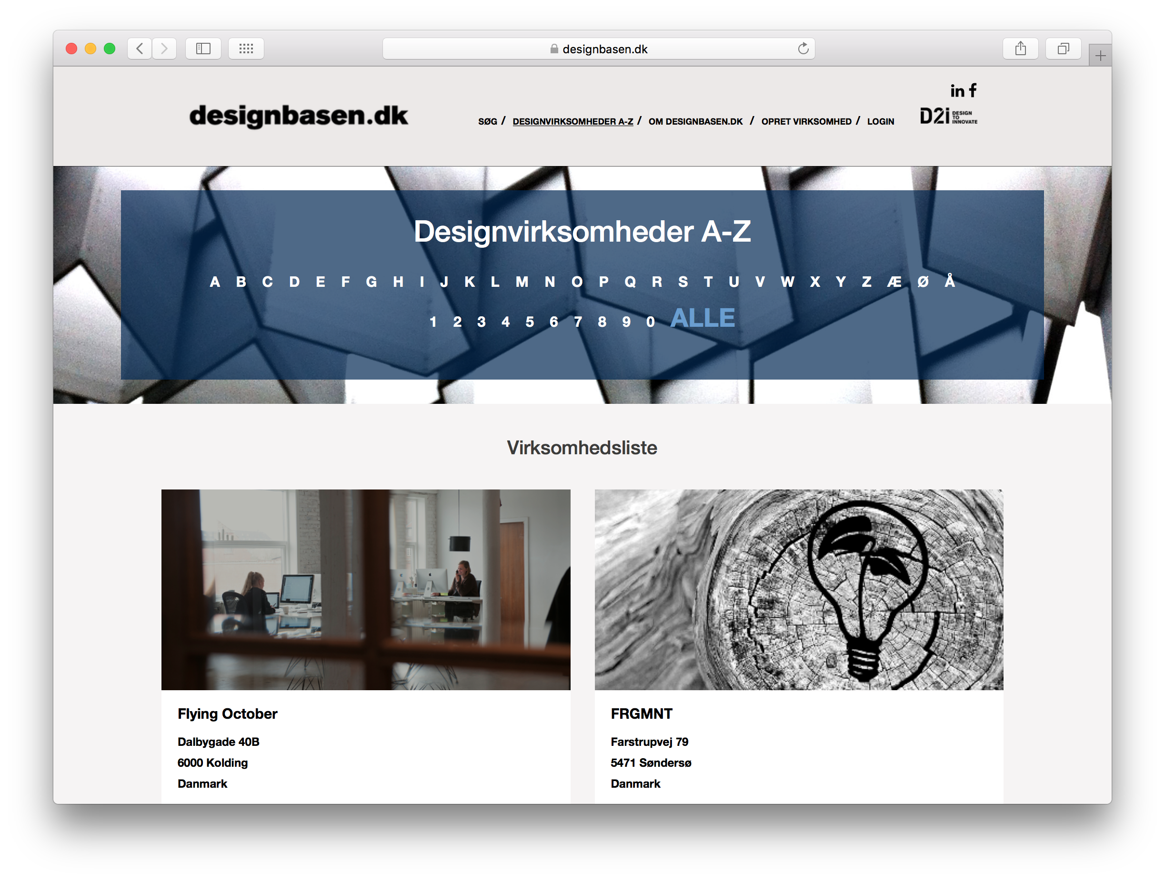

Slide 11
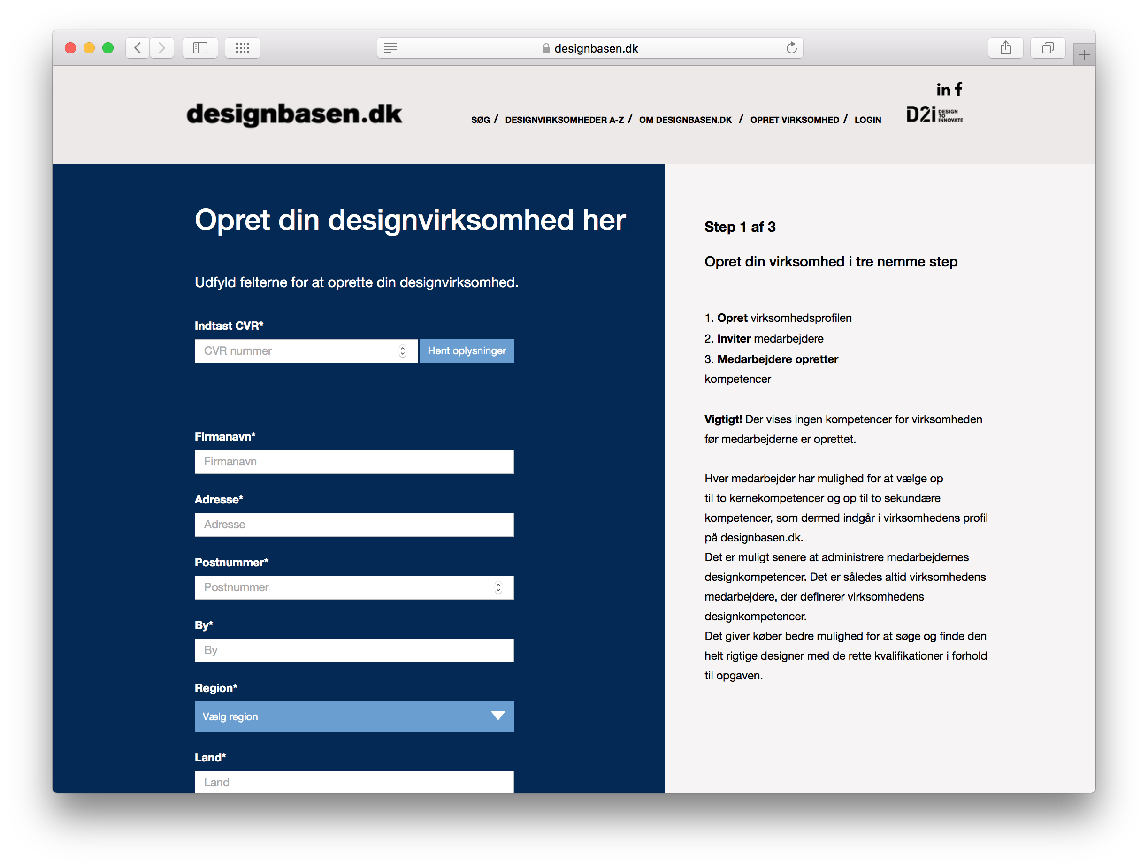

Slide 12
Kontakt:
Thomas Holst Madsen
Senior Design Consultant
designbasen@d2i.dk
+45 3114 9969

Slide 14
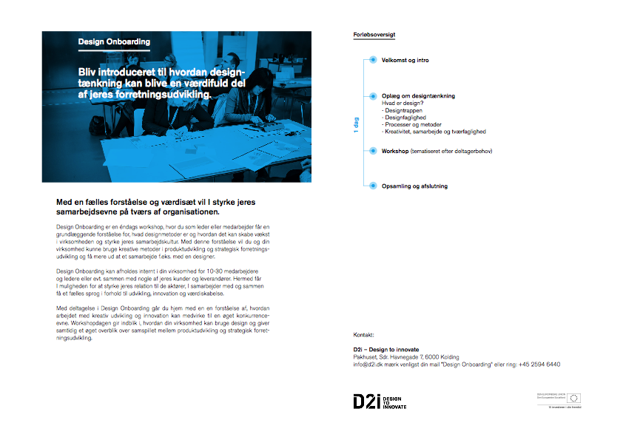

Slide 15
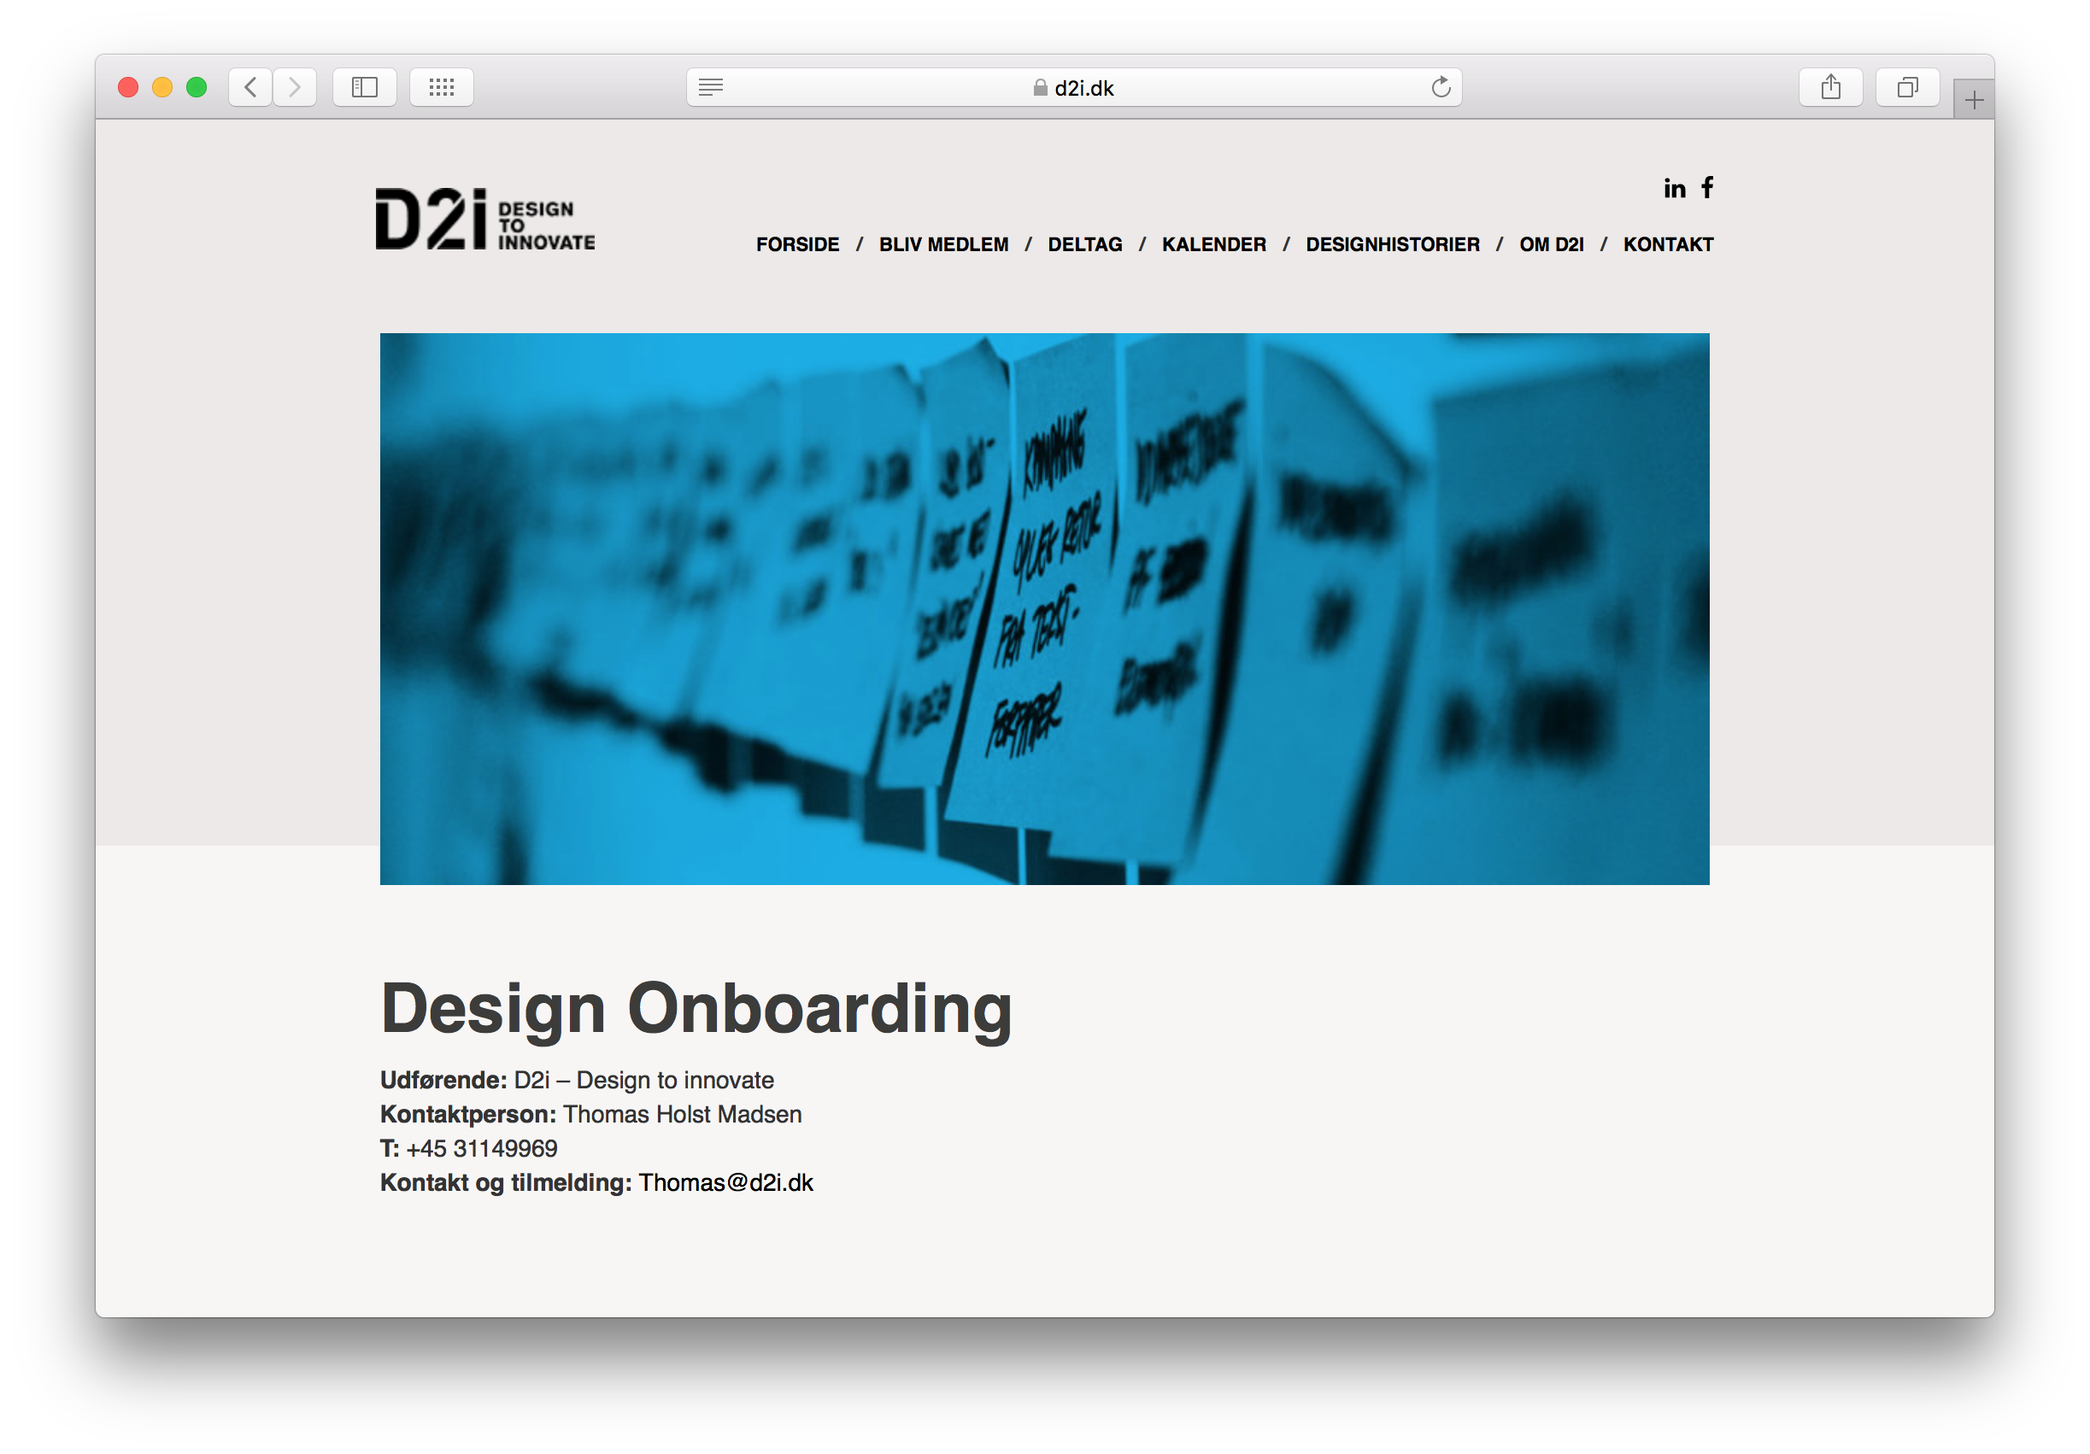

Slide 16
Kontakt:
Thomas Holst Madsen
Senior Design Consultant
thomas@d2i.dk
+45 3114 9969
www.d2i.dk

